Slide 1
Node JS Project Structure
Start a Node JS Project

Slide 2
Overview
Clone Project Struct:
git clone git@git.vsi-international.com:ipc/NodeJS-ProjectStructure.git
Install Project
Go to src folder
Refer to : installation-guide.md

Slide 3
Back-end Architecture
Router
Security
Validation
Converters
Error Handle
Library
Controllers
Services
Models

Slide 4
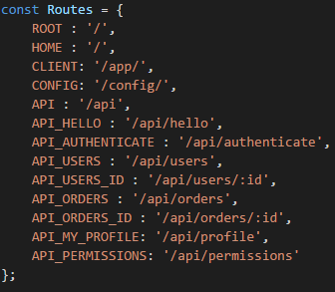
Router : Define the URL
Define Routes of the system – server/routes.js

Slide 5
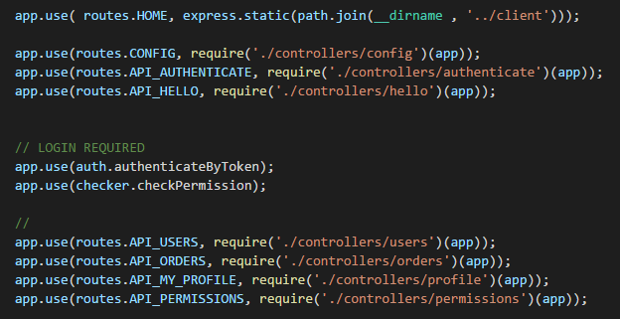
Router : Map to Controllers
Map to the Controllers – server/router.js

Slide 6
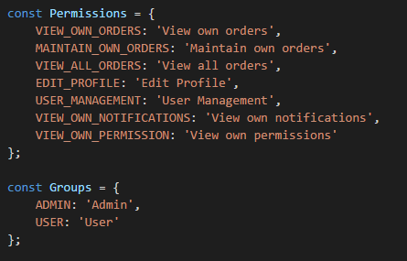
Security – Groups and Permissions
Define Groups and Permissions – server/security/permissions-groups.js
Defines Groups
Define Permissions
Define what permissions does the group has ( next page)

Slide 7
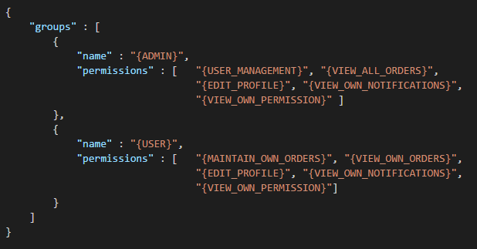
Security : Groups and Permissions
Define Groups and Permissions server/security/permissions-groups.js
Add Permission to Groups bin/data/permissions.json

Slide 8
Security : Permission to access system
Define the Permission for each Route.
The Route is defined on server/routes.js
Each Routes require Permission to access
User should has at least one permission on the required list to access the Route
Support HTTP Methods : HEAD, GET, POST, PUT, PATCH, DELETE

Slide 9
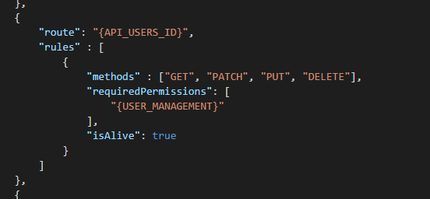
Security : Permission to access system
Example
Access to /api/users/:id – the API to access to specified user
Apply for methods : GET, PATCH, PUT, DELETE
Not apply to POST method
Permissions Required : User management
User needs to have User management permission to access this route

Slide 10
Controllers
Controller’s responsibility:
Receive Accepted request from Client
Validate submitted data ( server/validation/ )
Convert DTO (json) data to Domain Model and vice versa ( server/converters )
Call the Service to do the Business
Send the Response to Client
Controller folder: server/controllers
Node: Don’t do the business on Controller layer, do it on Service layer

Slide 11
Controllers
Security Layer
Routers
Client
Controller
Services
Model
Validation
Converter

Slide 12
Services
Working with Business
Working with Transactions
Working via many Data Sources (Models)
Write your service on server/services

Slide 13
Models
Working with Database via ORM with Relationship
Define Models and Relationship by StrongLoop tools:
slc loopback:model YourModel
slc loopback:relation
Node:
Don’t working with many Models on a Model
Each Model has only one responsibility
If you want to work with many tables, do that business on Services layer

